Slide 1
SafeGuard AI: Intelligent Accident Detection and Alert System
Datasets used :
ONCE(One millioN sCenEs) dataset
Audi Autonomous Driving Dataset (A2D2)
NuScenes CAN Bus
Dataset (2022)
Automating accident crash verification and alerting system

Slide 2
Key Features
Instant Accident Detection: SafeGuard AI utilizes advanced machine learning algorithms to analyze vehicle movement data in real-time. By monitoring sensor inputs such as accelerometers and gyroscopes, our system can accurately detect accidents the moment they occur, providing rapid response to emergencies.
Automated Alert System: When an accident is detected, SafeGuard AI automatically triggers an alert to emergency services, nearby vehicles, and designated contacts. This ensures that help arrives quickly, potentially saving lives and reducing the severity of injuries.

Slide 3
Key Features
Efficient Communication: Our system leverages wireless communication technologies to transmit accident data seamlessly. Whether it's through cellular networks, satellite communication, or dedicated short-range radios, SafeGuard AI ensures reliable communication even in remote or low-coverage areas.
User-Friendly Interface: SafeGuard AI features an intuitive user interface that allows users to monitor system status, receive alerts, and access emergency assistance with ease. With simple controls and clear visual indicators, our system empowers drivers and passengers to stay safe on the road.

Slide 4

Implementation in Brief
The Crux of this project idea is to formulate a computationally simple yet powerful on-board Machine Learning Algorithm built within the Micro-controller , coordinating between multiple Electronic Control Units (ECU’s), that can efficiently train on highly dynamic data obtained from sensors that are installed in vehicles such as
Accelerometers Purpose: Measure linear acceleration along multiple axes.
Function: Detect sudden changes in velocity, which can indicate impacts or collisions.
Cost: Accelerometers based on MEMS technology are cost-effective and widely available. ₹500 to ₹1000
Gyroscopes Purpose: Measure angular velocity and rotation rate.
Function: Provide information about vehicle orientation and rotational movements, helping to identify rollover or spin-out accidents. ₹500 to ₹1000
Cost: MEMS gyroscopes offer a cost-effective solution for measuring angular motion.

Slide 5
Implementation in Detail
Vehicle Dynamics Sensors:
Purpose: Measure parameters related to vehicle movement and dynamics.
Function: Provide contextual information such as wheel speed, steering angle, and lateral acceleration, enabling more accurate crash detection.
Cost: Sensors like wheel speed sensors ₹1000 and steering angle sensors are relatively affordable and commonly used in automotive applications.
Collision Detection Sensors (Optional) Purpose: Identify potential collision threats in the vehicle's surroundings.
Function: Supplement accelerometer and gyroscope data by detecting nearby objects or vehicles, helping to anticipate and prevent collisions.
Cost: Radar, lidar, or camera-based collision detection systems can be more expensive but may be justified for certain applications.
thereby deriving accurate insights for accident crash verification within 10 secs.

Slide 6
Implementation in Detail
Pressure Sensors:
Purpose: Measure changes in pressure within the vehicle cabin.
Function: Detect sudden pressure surges associated with airbag deployment or collision impact.
Cost: Affordable, typically ranging from ₹500 to ₹1500 (approximately $7 to $26) per unit.
Ublox NEO-6M GPS Module
Features: The NEO-6M module provides accurate positioning with support for multiple satellite systems including GPS, GLONASS, and Galileo. It offers fast time-to-first-fix (TTFF) and low power consumption, suitable for battery-operated devices.
Cost: Typically priced between ₹500 to ₹600 (approximately $7 to $13) per unit, making it a cost-effective option.
thereby deriving accurate insights for accident crash verification within 10 secs.

Slide 7
How this Works ?
On-board self-supervised Deep Learning model trains accordingly
Model verifies accident crash pattern and predicts severity from data
thereby deriving accurate insights and automated triggers (satellite calls or SMS ) for accident crash verification and information intimation to first responders like hospital ambulances, police stations within 10 secs. Moreover the particulars for that accident is automatically recorded into cloud servers for accident- scene restructure and big- data analysis in accident prevention algorithms in the near future.
Sensors provides data dynamically
Crash happens
Lives saved quickly
Wireless & Mobile-less communication of location and severity to emergency first responders (Ambulance & police)
No response or negative response

Slide 8
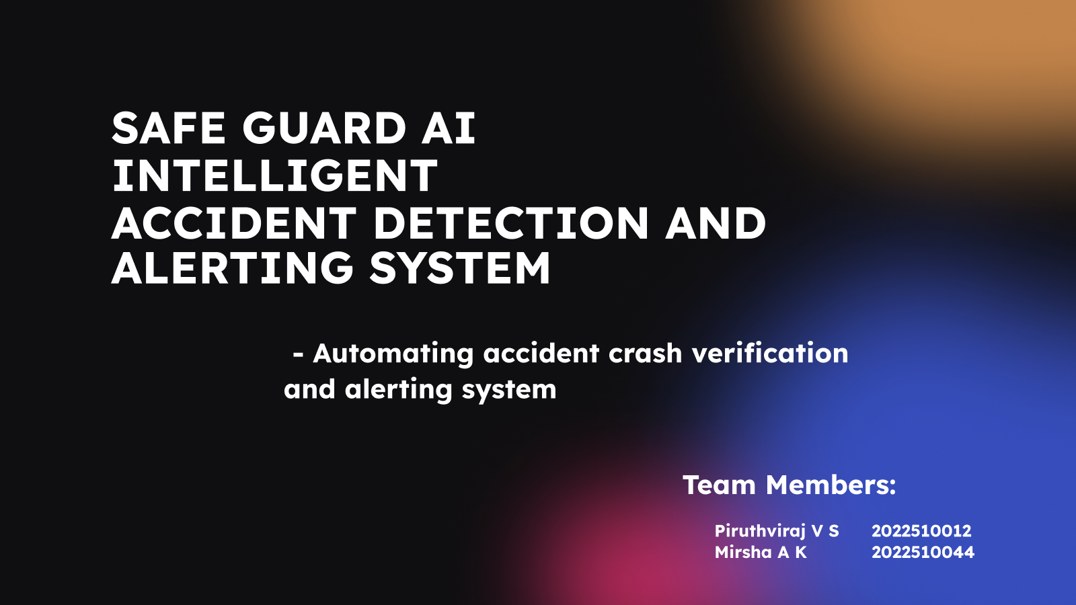

Slide 9
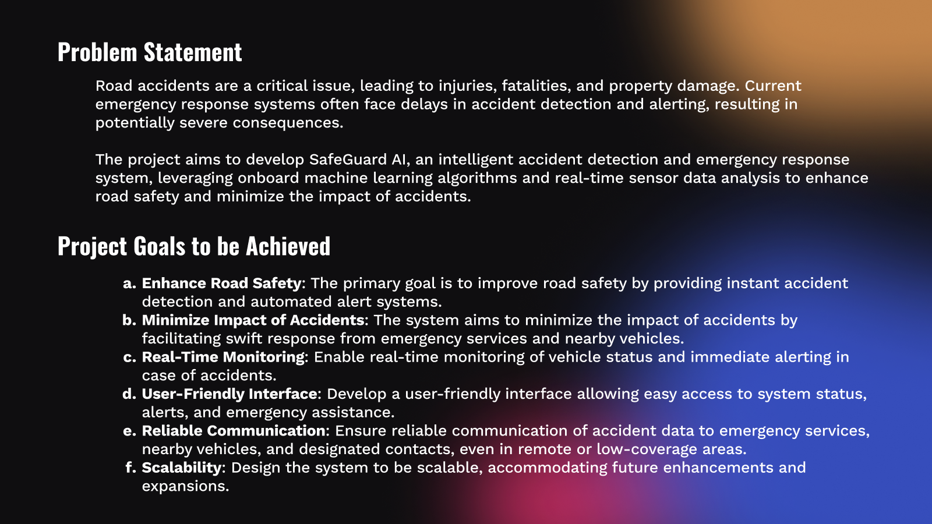

Slide 10
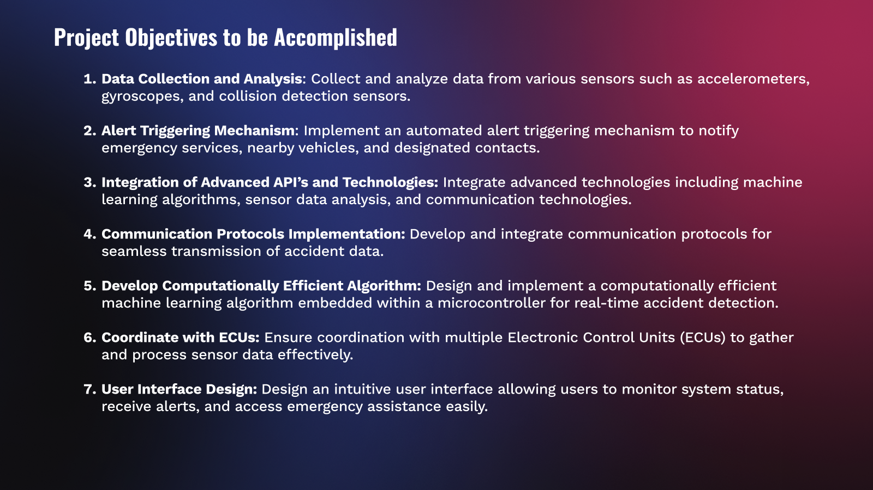

Slide 11
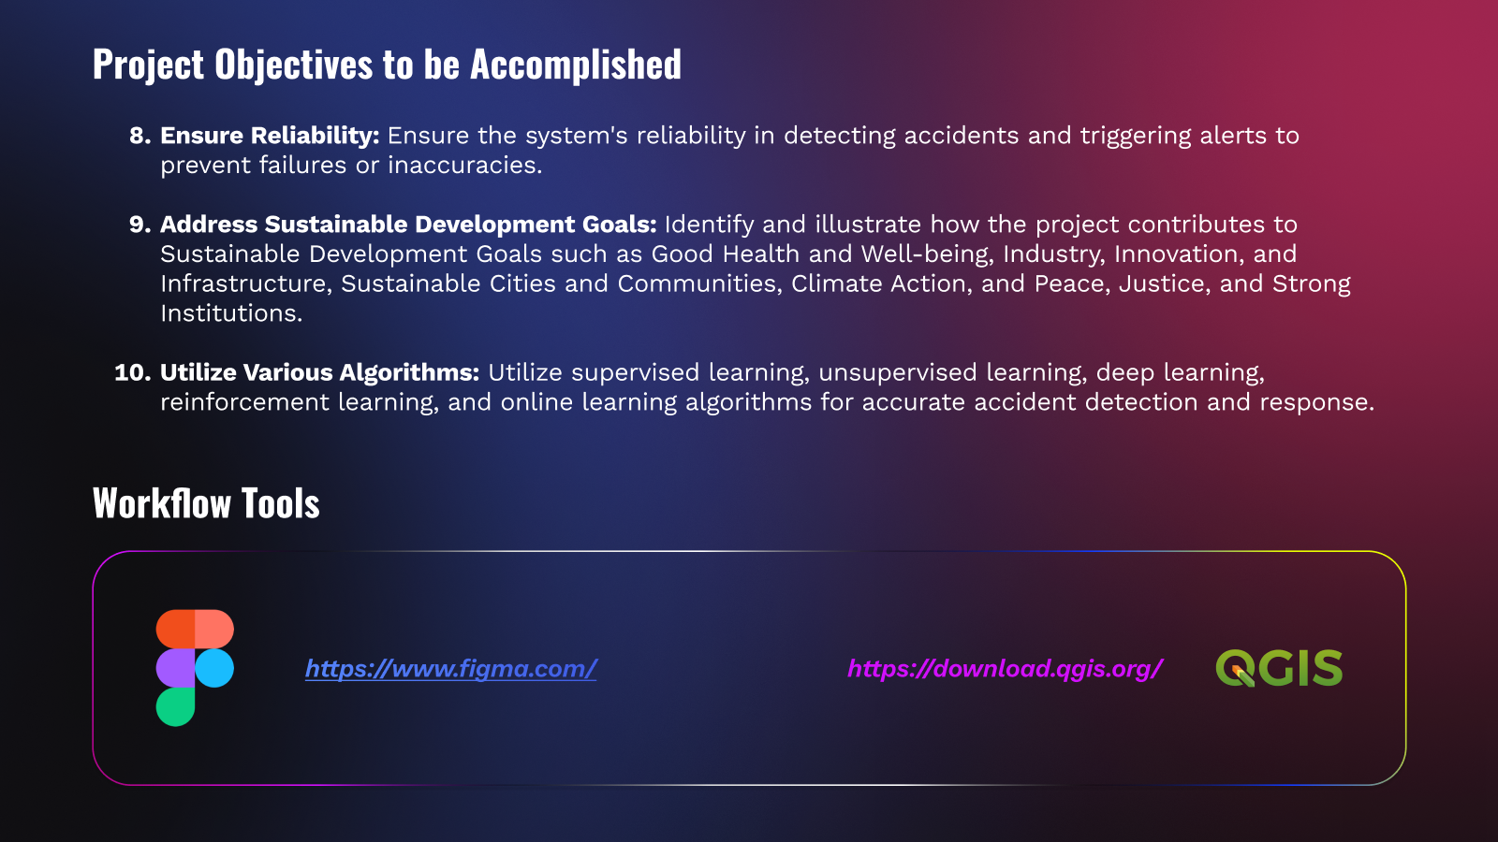

Slide 12
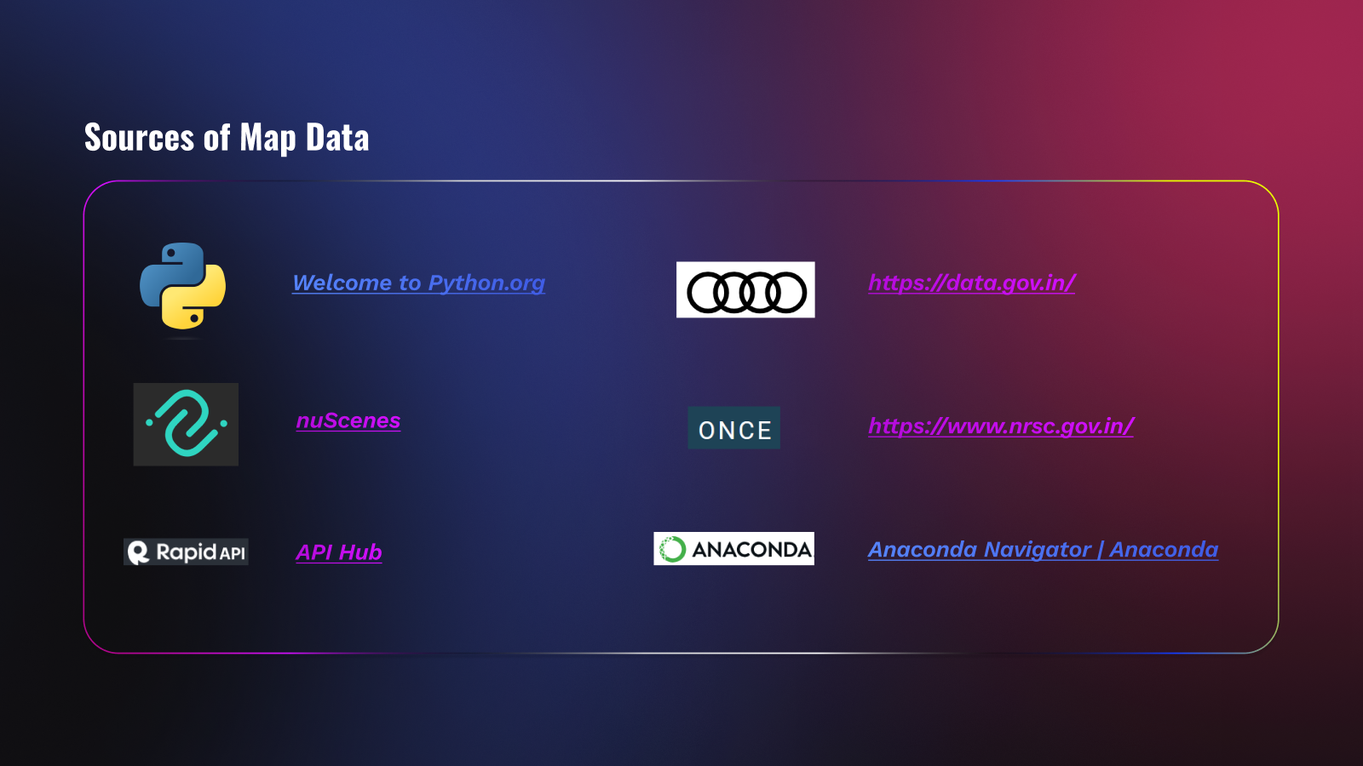

Slide 13
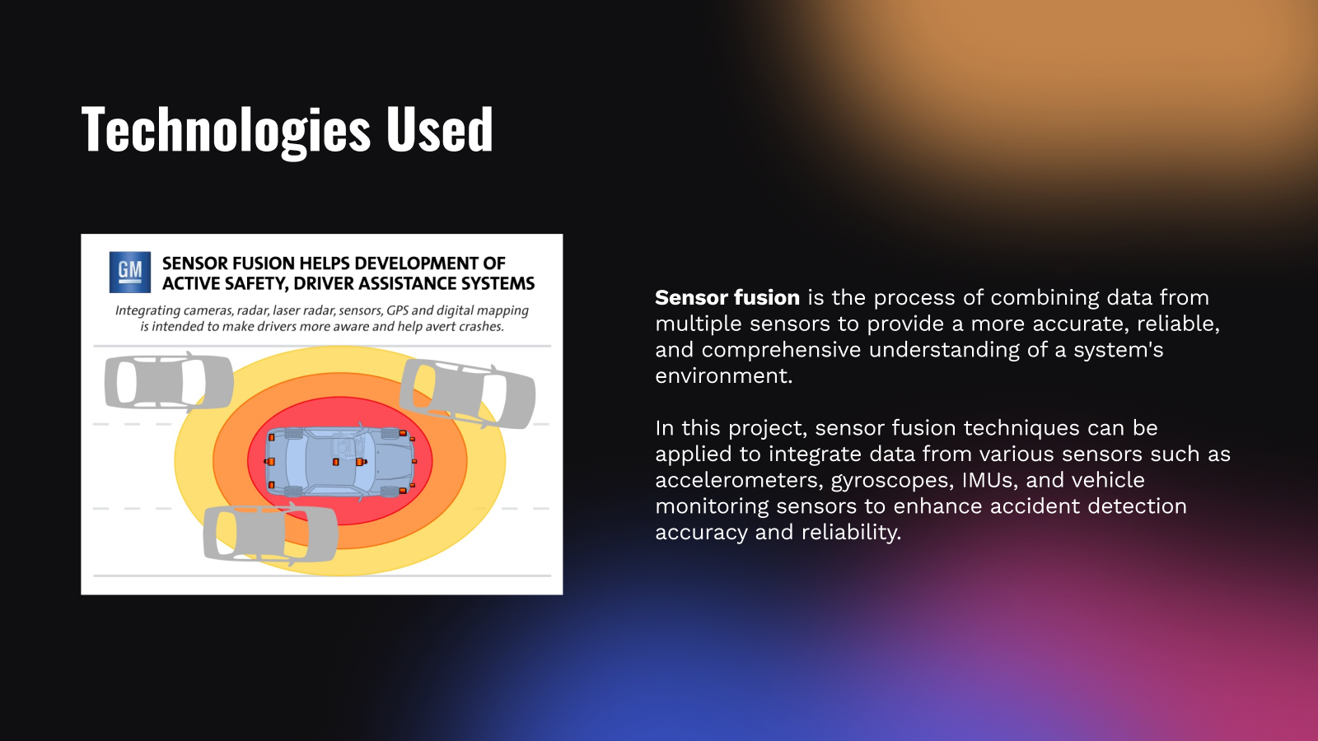

Slide 14
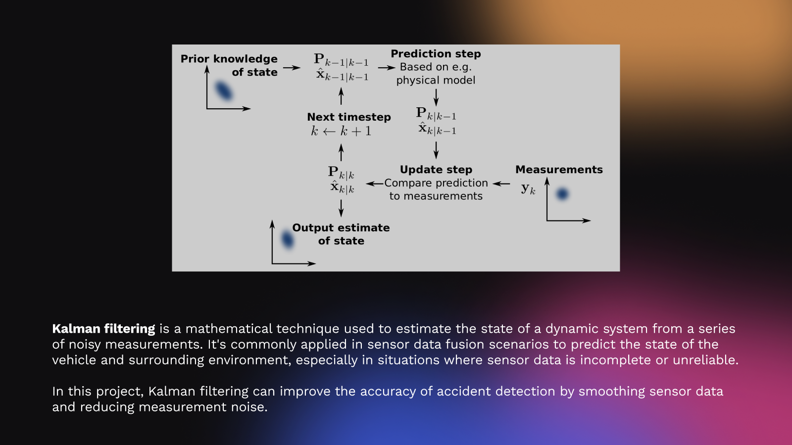

Slide 15
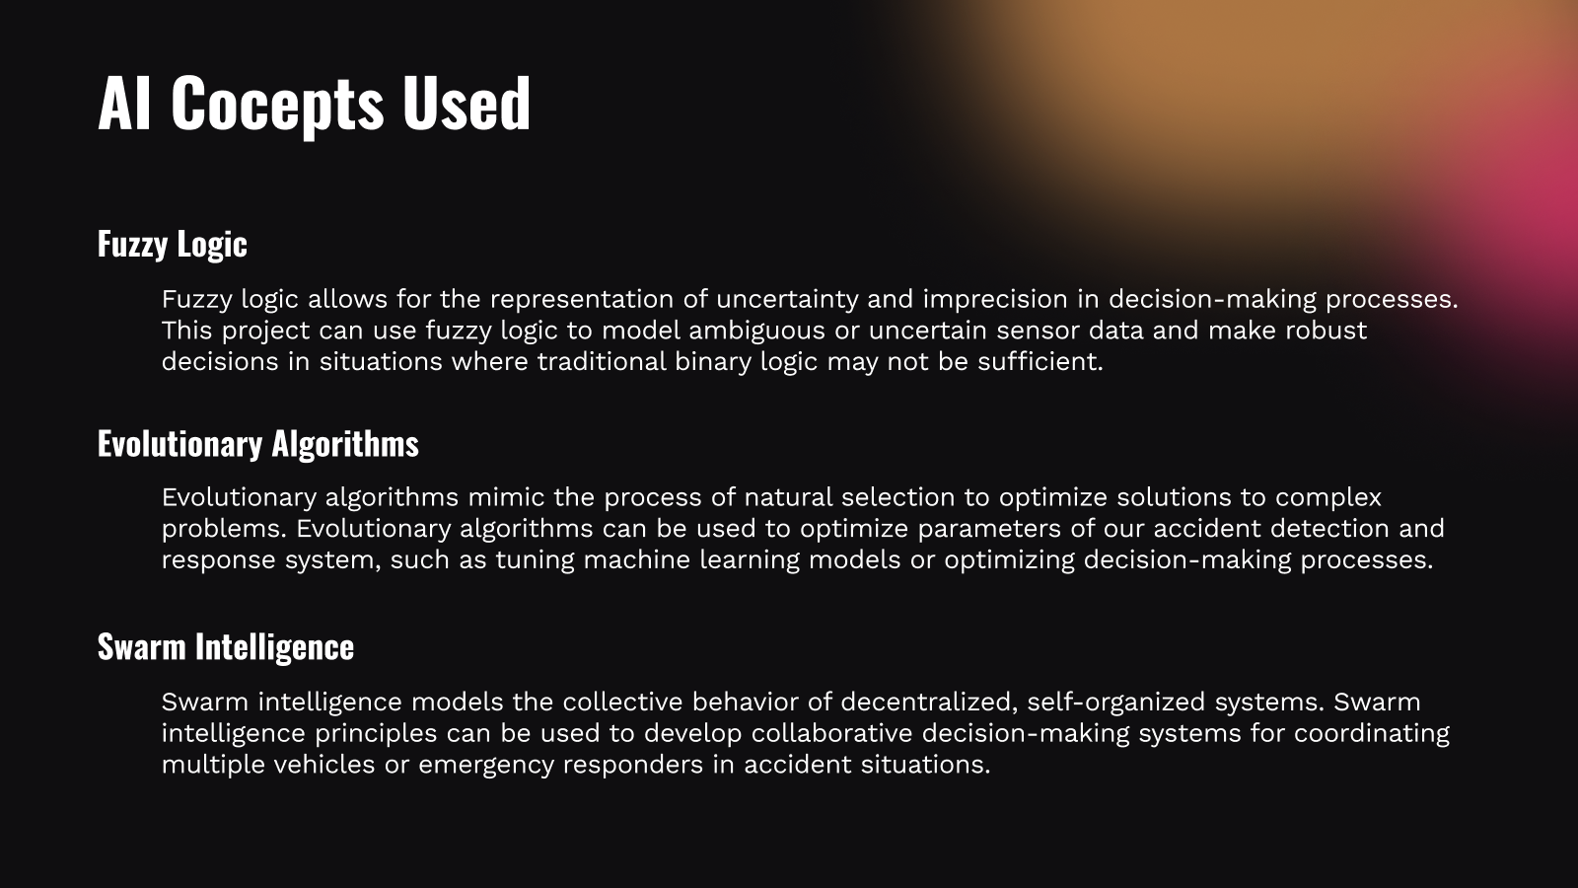

Slide 16
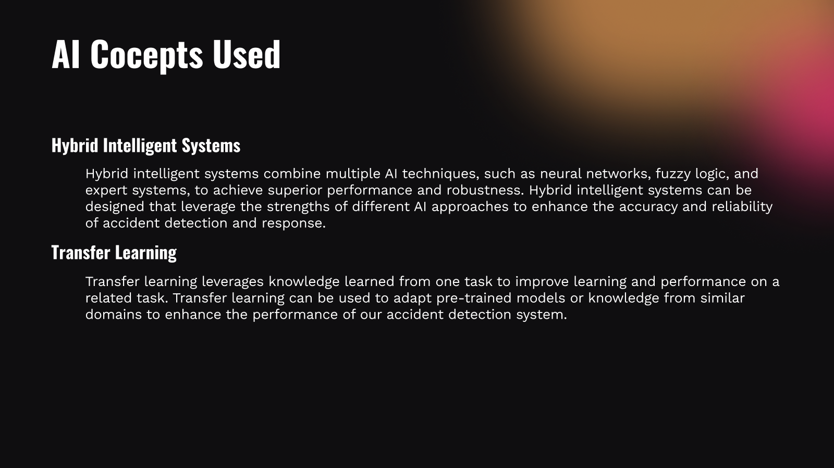

Slide 17
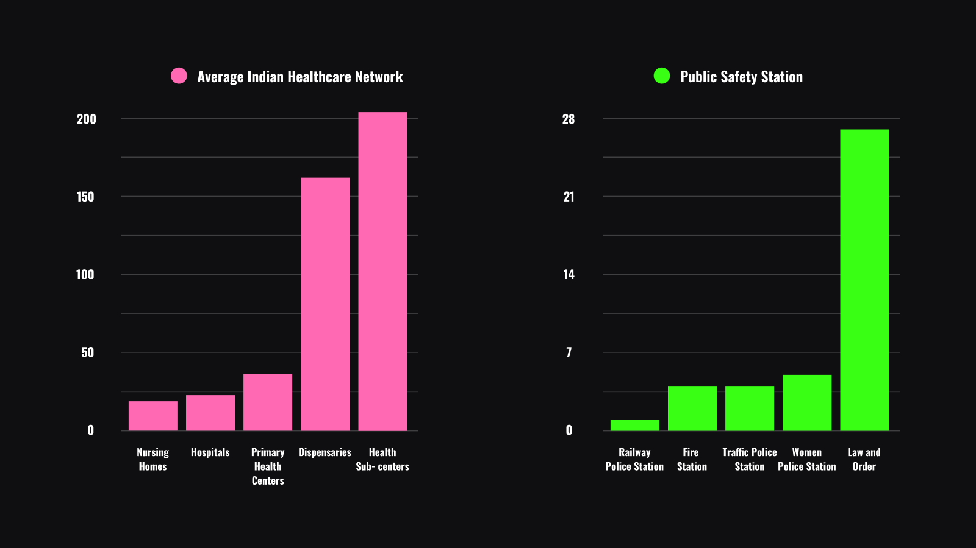

Slide 18
